Slide 1


Accenture
DATA ANALYTICS AND MORE

Slide 2


Today's agenda
Project recap
Problem
The Analytics team
Process
Insights
Summary

Slide 3

Social Buzz is a social and content-creation
company whose rapid growth has necessitated the
engagement of an advisory firm to prepare for an
IPO, manage their scaling needs and learn the best
data practices from larger corporations.
Accenture within three months is tasked with:
1. auditing of Social Buzz’s big data practices
2. providing IPO recommendations
3. analyzing popular content category
The aim is to show that Accenture is the best firm
for Social Buzz’s challenges.
Project Recap

Slide 4

Problem
Analysis to find TOP 5 MOST POPULAR categories of content out of the over 100,000 daily posts accumulated over the period of 5 years.

Slide 5



Justice Inkoom
Data Analyst
The Analytics team
Marcus Rompton
Senior Principle
Andrew Fleming
Chief Technical Architect

Slide 6
Process
1
Data Understanding
2
Data Cleaning
3
Data Modelling
4
Data Analysis
5
Uncover Insights

Slide 7

Insights
The analysis focused on the top 5 content categories based on the scores obtained, the category with the most reactions, and the month that has the most posts.
It was observed that there were 16 unique categories of contents, namely:
Studying
Healthy eating
Technology
Food
cooking
Dogs
Soccer
Public speaking
Science
Tennis
Travel
Fitness
Education
Veganism
Animals
Culture

Slide 8
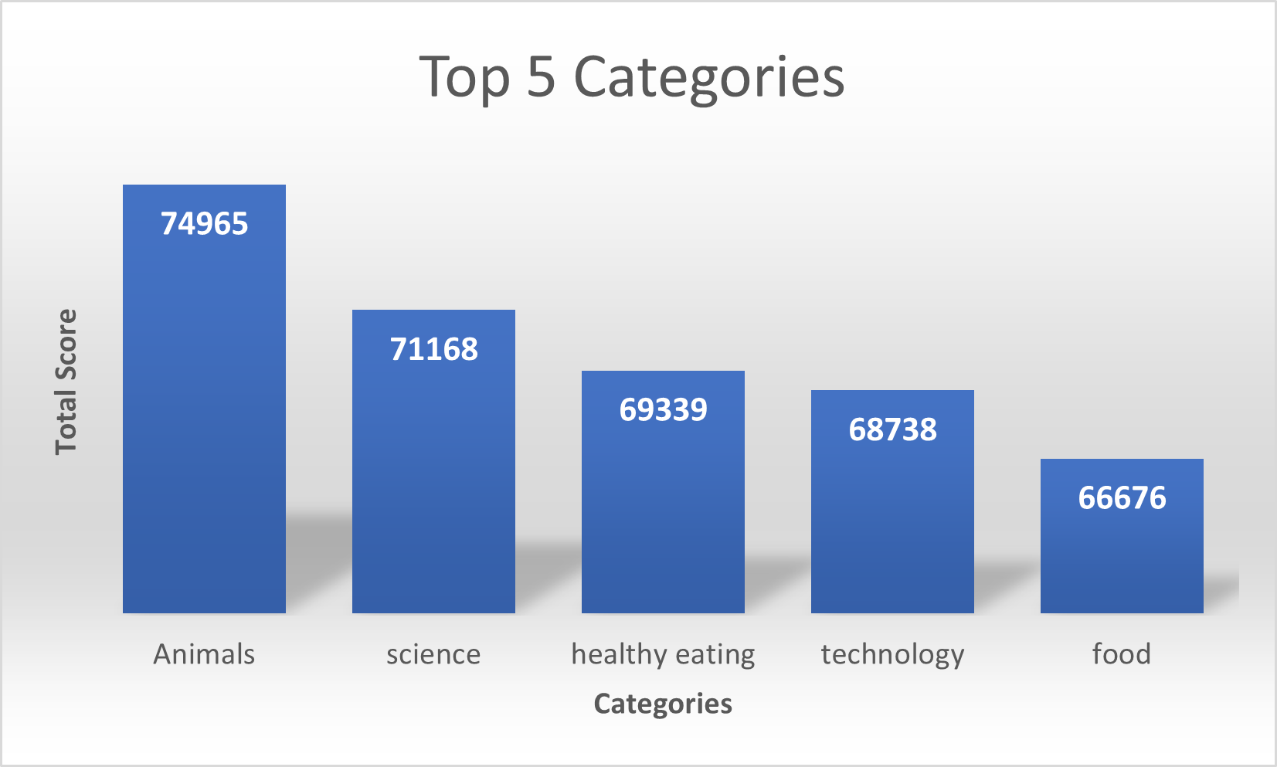
Insights Cont’d.
The top 5 categories of content are; Animals, science, healthy eating, technology and food.
The Animals category is the top-most category with the highest total score of 74,965.
The food category came last with a total score of 66,676.

Slide 9
Insights Cont’d.
CATEGORY | REACTION COUNT
Animals | 1897
Science | 1796
Healthy eating | 1717
Food | 1699
Technology | 1698
The Animals category turned out to be the category with the most reactions count with a total of 1897 reactions and technology came 5th with a total of 1698.
MONTH | POST COUNT
May | 2138
Jan | 2126
Aug | 2114
Dec | 2092
Jul | 2070
The month May happened to the month with the most posts with a total count of 2138 and July came 5th with 2070 posts.

Slide 10

ANALYSIS
The most favored types of content are animals and science, indicating that people have a strong preference for "real-life" and "factual" material.
INSIGHTS
Healthy eating, technology and food are part of the top 5 categories. This insight can be used to collaborate with healthy product and technology brands for marketing campaigns especially in the month of May where there are a lot of posts and reactions.
WAY FORWARD
While this ad-hoc analysis provides valuable insights, it's now essential to transition into large-scale production for real-time business understanding. We can guide you on how to achieve this.
Summary

Slide 11
Thank you!
ANY QUESTIONS?

